Slide 1
Citizen Scientists Tackling Devastating Floods and Disaster Relief with Semi-supervised Deep Learning
Siddha Ganju*, Sayak Paul*
Code: bit.ly/etci-code | Paper: bit.ly/etci-paper
* = Equal Contribution

Slide 2
Agenda
What are floods and who does it impact?
Where are we today in Flood segmentation?
How can YOU as a citizen scientist make a difference?
How can you get started today?

Slide 3
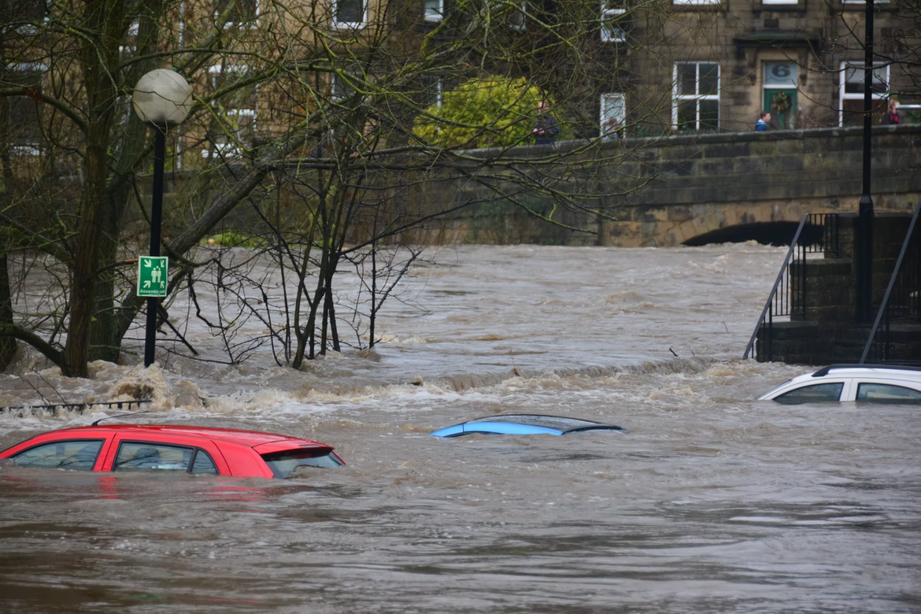
About Floods
Cause more than $40 billion/year in damages worldwide
40% of the world’s population lives close to coasts
Flooding events are on the rise due to climate change, increasing sea levels and extreme weather events (cloud bursts)
Flood levels estimation needs to be done remotely as physical access to flooded areas is limited
Deploying instruments in potential flood zones can be dangerous

Slide 4
Current state of Floods Segmentation

Slide 5
What’s SOTA in Flood Segmentation?
No joint directive - all organizations are doing their own thing.
WorldFloods Dataset and techniques provides Sentinel-2 flood maps for 119 global flood events. Deployed on Intel Movidius Myriad2 on PhiSat (launched via SpaceX in 2021) https://www.nature.com/articles/s41598-021-86650-z.
UNOSAT provides public data consumable by domain scientists http://floods.unosat.org/geoportal/.

Slide 6
How to evaluate solutions?
Scalability (is this useful for my community and country?)
Generalizability (is this useful for my geographic location?)
Accessibility (can I use it?)
Deployment in real time (will the result be ready quickly enough?)

Slide 7
How can YOU as a citizen scientist make a difference?
Crowdsource AI+ML knowledge for interdisciplinary high-value public impact work.
Push boundaries of research and deployment.
Bring disaster preparedness in society & work towards Climate Change.
A citizen science team devised a semi-supervised based pseudo-labeling solution for the NASA IMPACT flood segmentation challenge. The team used NVIDIA V100 GPUs for training on the Google Cloud Platform and released all the code and trained models in open source, encouraging future citizen scientists to join the climate security challenge.

Slide 8
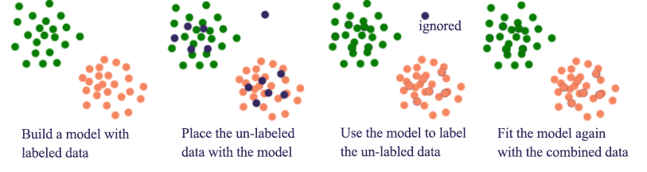
What is Semi-Supervision in Deep Learning?
Figure: https://jhui.github.io/2017/01/15/Machine-learning-nonsupervised-and-semi-supervised-learning/

Slide 9
Why Semi Supervised Deep Learning methods?
Feature based machine learning techniques are intractable as human annotators and featurizers cannot scale.
Manual annotation in real time can easily exceed $62,500 daily.
Not scalable for petabytes worth of data captured by satellites every day.
Cannot get flood images from every single part of the world.

Slide 10
How can YOU use this work?
For Government organizations:
Use the new state of the art AI based flood segmentation method to monitor and plan for flooding events
Disaster planning and relief
For citizen scientists:
Educate communities about the impact of floods
Learn about AI techniques
Understand reproducibility
Create plan-of-action for potential flooding event in your area
Climate Change
Get started TODAY
Code: bit.ly/etci-code | Paper: bit.ly/etci-paper

Slide 11
Get started TODAY:
Use the #2 winning solution from the NASA Impact ETCI Competition

Slide 12
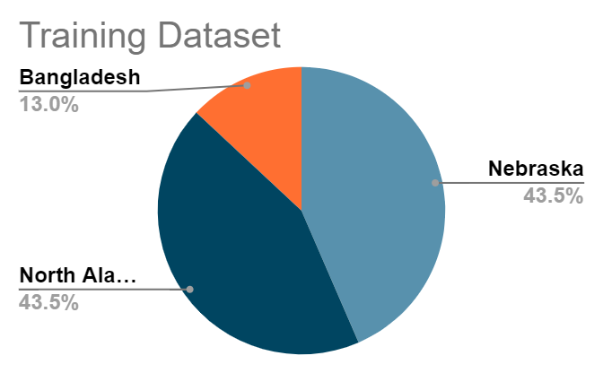
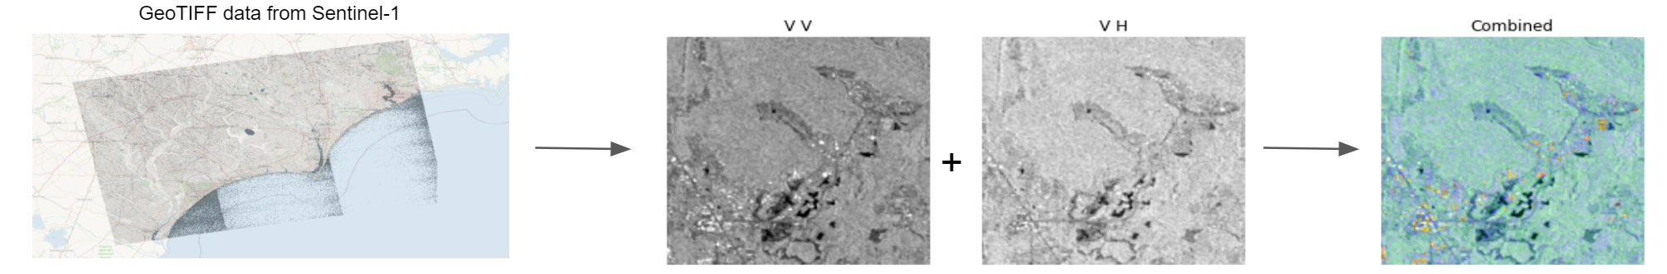
Data Analysis
66k tiled images from Nebraska, North Alabama, Bangladesh, Red River North, and Florence
Validation = Florence
Test = Red River North
Code: bit.ly/etci-code | Paper: bit.ly/etci-paper
Notes:
The Red River geographic area which is predominant in the test set,
is primarily an agricultural hub and recently harvested fields can look similar to floods
due to low backscatter in both VV and VH polarizations.
Similarly Florence which comprises of the validation set has a primarily urban setting.
Observing this potential uncertainty motivated us to combine different forms of ensembling with stacking,
and, test-time augmentation. Both stacking and test-time augmentations combined predictions from the various
trained models helping model uncertainty and ultimately making the predictions robust.

Slide 13
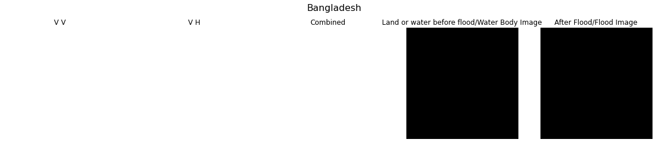
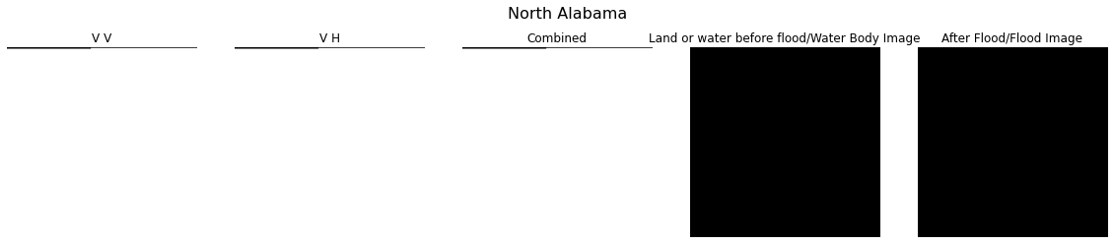
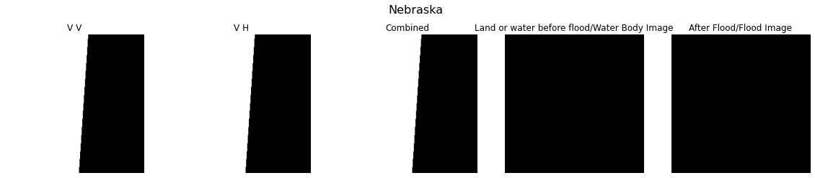
Data Processing - Removing images with swath gaps
Notes:
Also contains swath gaps where less than .5% of image pixels present. Such images do not contribute substantial information and are removed.

Slide 14
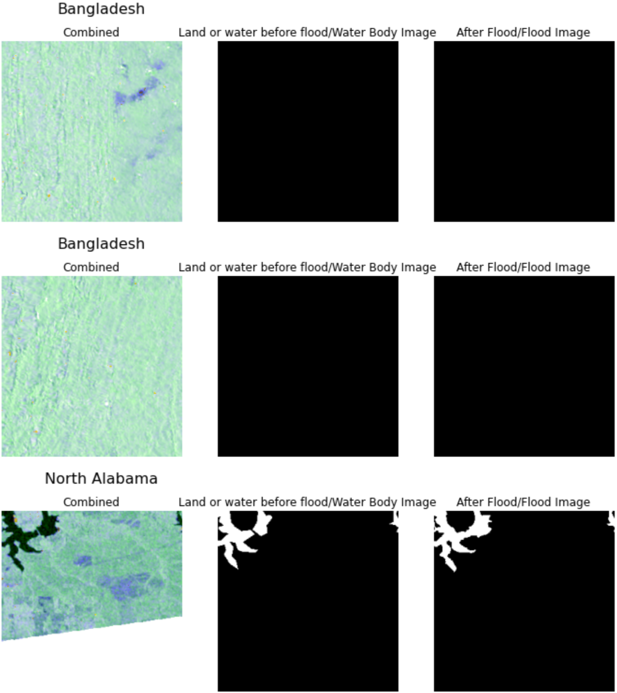
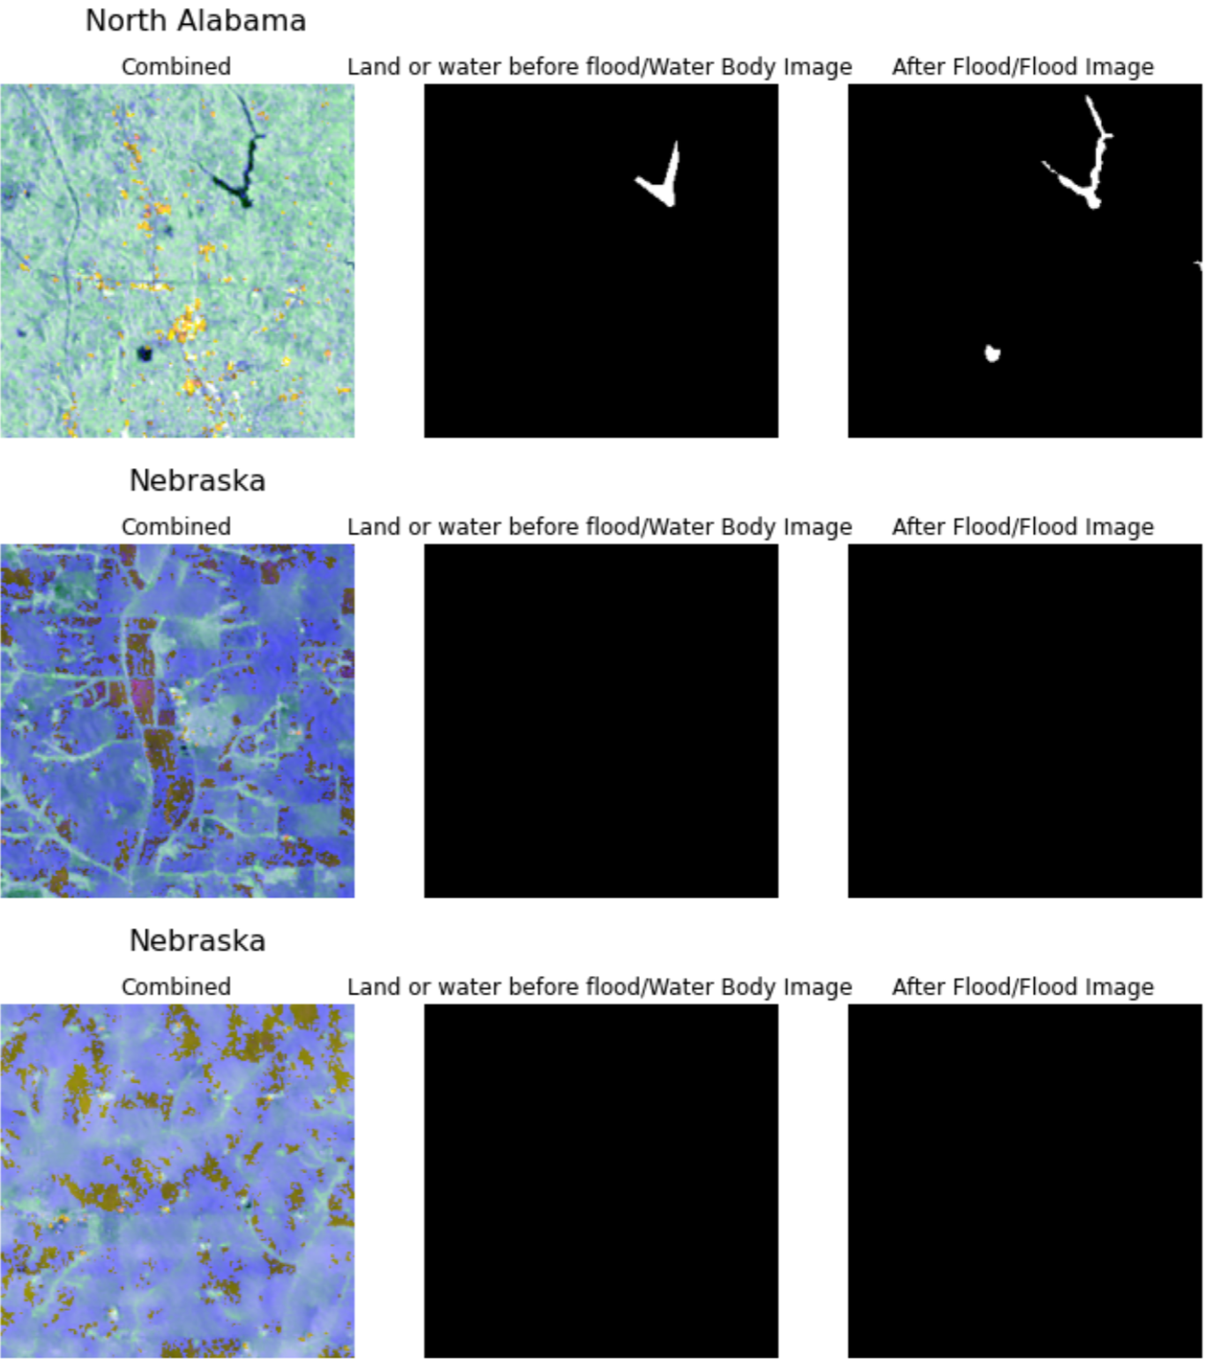
Data Processing - Generating RGB tiles with ESA Polarimetry
Notes:
RGB Tiles generated using Hybrid Pluggable Processing Pipeline hyp3 from VV & VH GeoTIFF files
We note the visiblegrains in different directions potentially due to recently harvested agricultural fields from Bangladesh.North Alabama show various artifacts including potential swath gaps due to differences in satellitecoverage, while the RGB color range in Nebraska is unique. The North Alabama image with swathgaps is kept because of at least some positive ground truth artifacts (after flood) available.

Slide 15
Sampling data
Timestamps
Intuitively could tell the progress of flooding events.
Empirically no impact with random sampling or maintaining ordered pairs.
Stratified sampling
Each training batch contained at least 50% of samples having flood levels.
This also helps mitigating the class imbalance problem in the dataset.

Slide 16
Augmentation
Training: horizontal flips, rotations, and elastic transformations.
Test-time: horizontal, vertical flips, transpositions and 90 rotations (Dihedral Group D4).

Slide 17
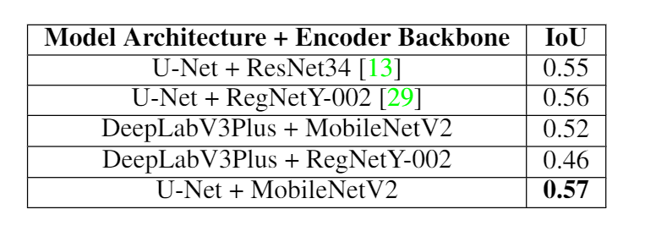
Training details
Encoder backbone: MobileNetV2 due to its pointwise convolutions and performance consistency.
Segmentation architectures: UNet and UNet++.
Loss function: Performance improvement with Dice loss alone compared to Focal loss and the two combined.
Notes:
pointwise convolutions + boundary details present inside the Sentinel-1 imagery are extremely fine

Slide 18
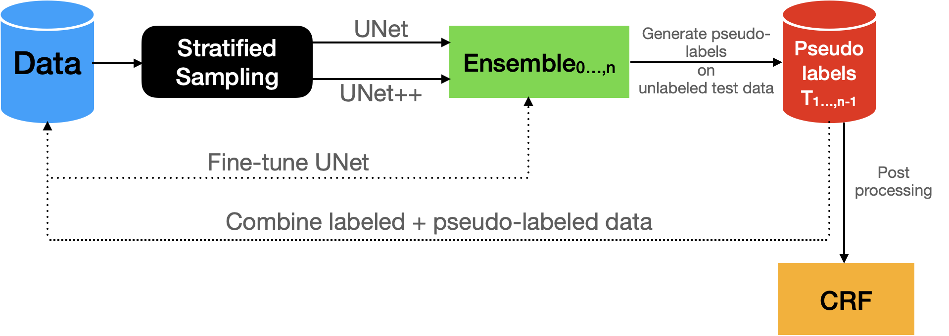
Training with pseudo labeling

Slide 19
Training with pseudo labeling
Step 1: Training on available data, performing inference on entire test data, and generating Pseudo Labels
Step 2: Filtering quality pseudo labels
Step 3: Combining Pseudo Labels + Original Training data
Repeat Steps 1,2,3
Post processing with CRFs

Slide 20
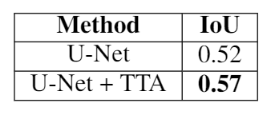
Inference
Using test-time augmentation (TTA) during inference in our case significantly helped boost performance. The trained model in both cases is consistent with a U-Net architecture with MobileNetV2 backend.

Slide 21
Post processing with CRFs
We used Conditional Random Fields (CRF) to post-process the predictions.
CRFs helped refining the segmentation boundaries resulting in better final performance.

Slide 22
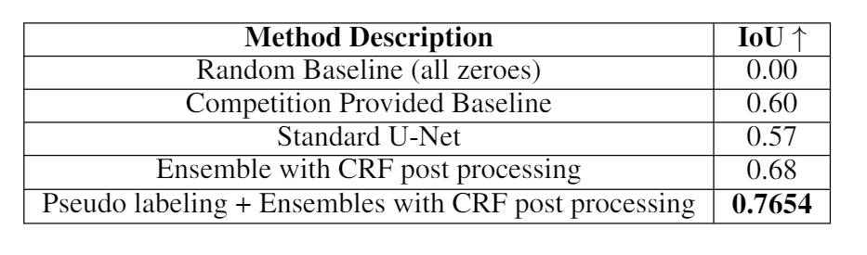
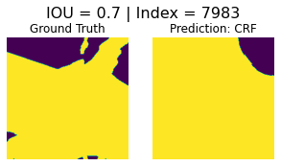
Results

Slide 23
Importance of ensembling
Paramount in modeling the uncertainty.
It’s pros lie in its simplicity.
We used ensembling in two flavours:
Standard geometric ensembling of models during inference.
Test-time augmentation during inference.

Slide 24
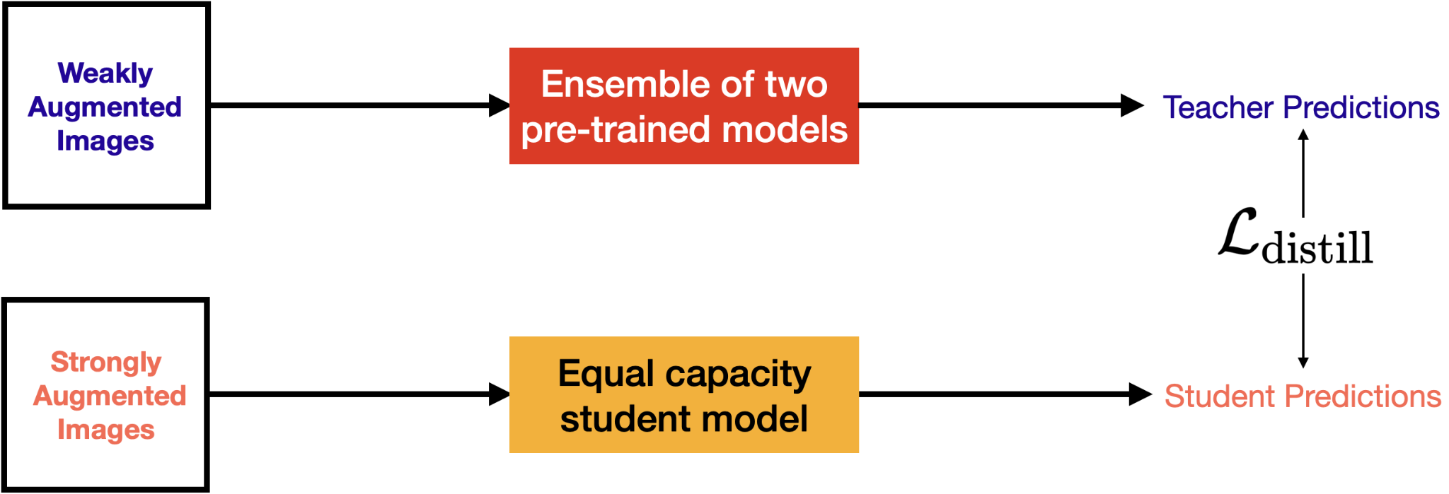
Noisy Student Experiments
NST is an interesting semi-supervised learning paradigm introduced by Google Brain in 2019.
It is also particularly helpful when dealing with distribution shifts.

Slide 25
Noisy Student Experiments
Our extension of NST used the same method for obtaining quality pseudo-labels.
It also helped cutting down the iterative training procedure drastically reducing the overall training time.
For inference, we used UNet and UNet++ trained with our NST extension.
Performance-wise it yields 0.75 IoU.

Slide 26
Other training details
Frameworks and others
PyTorch primarily for model training, other open-source frameworks like timm, smp for model building, and pydensecrf for applying CRF.
Standard Adam optimizer with the default from torch.optim.adam.
Mixed-precision and distributed training with torch.cuda.amp and torch.nn.parallel.
Hardware
4 x V100 GPUs on GCP.

Slide 27
Benchmarking
Segmentation masks are generated in approx 3 seconds per Sentinel-1 tile.
Covers an area of approximately 63,152 squared kilometers!
Larger than the area covered by Lake Huron, the second largest fresh water Great Lake of North America.

Slide 28
Future work
Eliminate CRFs because they are computationally expensive.
Develop a single end-to-end training workflow to make the process more streamlined.
More suitable architectures for segmenting satellite imagery.
Collaborating with the competition organizers and UNOSAT team to benchmark real time runtimes and to evaluate the scalability of our solution.

Slide 29
Acknowledgements
NASA Earth Science Data Systems Program, NASA Digital Transformation AI/ML thrust, and IEEE GRSS for organizing the ETCI competition.
Google Developers Experts* program for providing Google Cloud Platform credits to support our experiments.
Charmi Chokshi and domain experts Shubhankar Gahlot, May Casterline, Ron Hagensieker, Lucas Kruitwagen, Aranildo Rodrigues, Bertrand Le Saux, Sam Budd, Nick Leach, and, Veda Sunkara.
* https://developers.google.com/programs/experts/

